Slide 1
Expressions in AngularJS
G. Sravan Sai
22H51A0527
CSE-D

Slide 2

Expressions in AngularJS
Expressions in AngularJS are used to bind application data to HTML.
The expressions are resolved by AngularJS and the result is returned back to where the expression is written.
The expressions in AngularJS are written in double braces: {{ expression }}.
They behave similar to ng-bind directives: ng-bind=”expression”.

Slide 3

Introduction to AngularJS Expressions
AngularJS expressions are a cornerstone of data binding. They allow you to dynamically display and interact with data in your AngularJS applications.
1
Data Binding
The key concept behind AngularJS expressions is data binding. This means that the view (HTML) is automatically updated whenever the data in the model changes, and vice versa.
2
Dynamic Content
Expressions enable the creation of dynamic content that reacts to changes in the underlying data.
3
Simplified Development
Expressions simplify development by eliminating the need for manual DOM manipulation, allowing you to focus on the logic and data of your application.

Slide 4
Syntax of AngularJS Expressions
The core syntax of an AngularJS expression is simple and intuitive. It involves wrapping the expression within double curly braces.
Basic Syntax
Example
Difference
{{ expression }}
2 + 2 = {{ 2 + 2 }}
AngularJS expressions differ from JavaScript expressions in their scope and context. They are evaluated within the AngularJS scope and are specifically designed for data binding.
This syntax is used to bind the evaluation of the expression to the view.
AngularJS evaluates the expression "2 + 2" and displays the result "4" within the HTML.

Slide 5
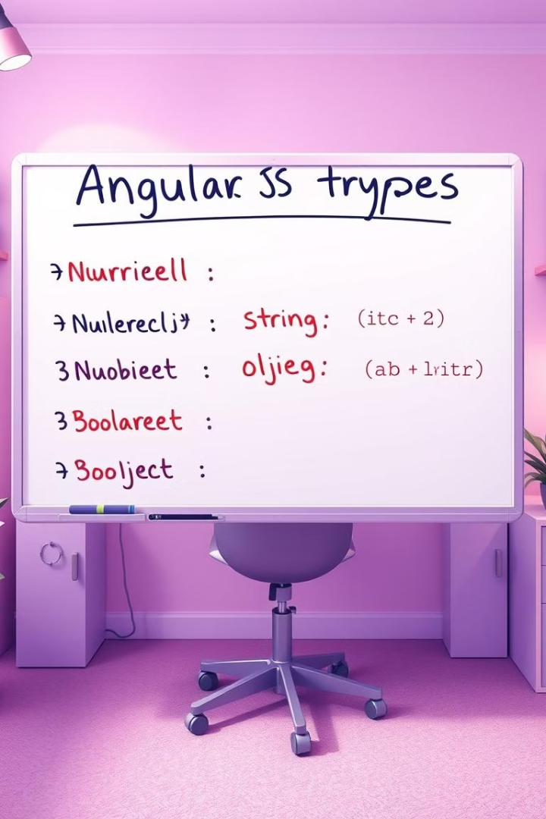
Types of Expressions
AngularJS expressions support various types of data, allowing you to manipulate and display data in different formats.
Number Expressions
Evaluate numeric values using standard arithmetic operators.
String Expressions
Handle string operations like concatenation, substring extraction, and case
conversions.
Boolean Expressions
Evaluate conditions and return true or false values.
Object Expressions
Access and manipulate properties of objects, including nested properties.

Slide 6



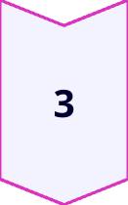
AngularJS Expressions with Objects
Using expressions, you can easily bind data from objects to the view, displaying dynamic content based on object properties.
Object Property Access
Expressions can access object properties by using the dot notation.
Data Binding
The result of the expression is automatically bound to the view.
Dynamic Content
This allows you to create dynamic content based on the values of object properties.

Slide 7
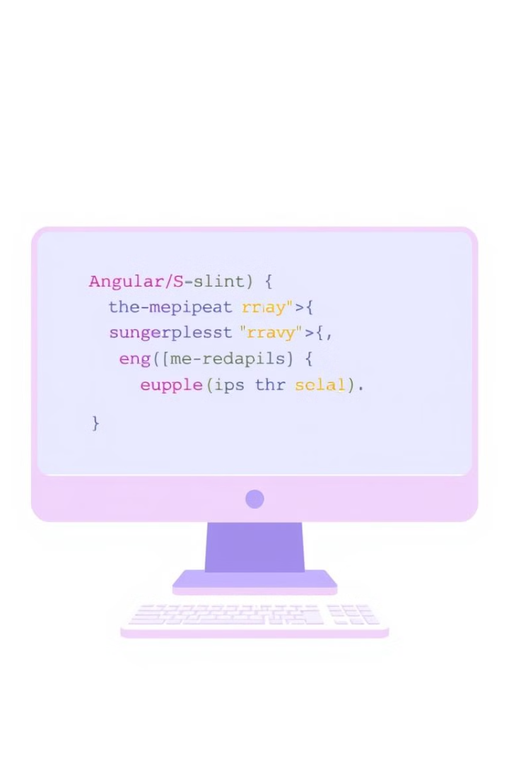
AngularJS Expressions with Arrays
Expressions are powerful when working with arrays, allowing you to iterate over elements and display dynamic lists based on array data.
ng-repeat
Iterates over array elements.
{{ expression }}
Binds data from the array element to the view.

Slide 8
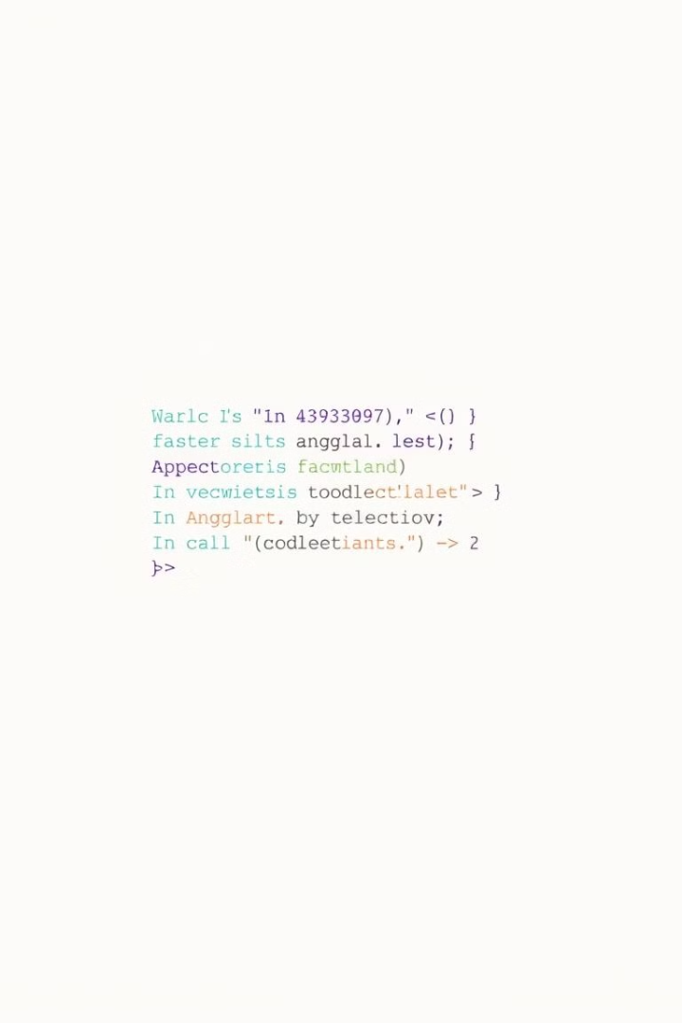
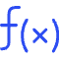


AngularJS Expressions with Functions
Expressions allow you to call functions within your AngularJS templates, enabling dynamic behavior based on function results.
Function Calls
Expressions can call functions defined in the scope.
Dynamic Values
The result of the function call is used to generate dynamic values in the view.
Data Flow
Functions can be used to manipulate data before it is displayed in the view.

Slide 9

Error Handling in AngularJS Expressions
AngularJS gracefully handles errors within expressions, ensuring that your application continues to function smoothly.
1
Error Detection
AngularJS detects errors that occur within expressions.
2
Graceful Handling
These errors are handled without halting the application.
3
User Experience
This minimizes disruptions to the user experience.

Slide 10

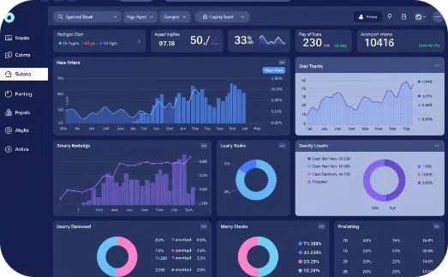

Applications of AngularJS Expressions
AngularJS expressions are a core component of building robust and dynamic web applications. They provide the foundation for interactive elements and data-driven user experiences.
E-commerce Apps
Real-Time Dashboards
Social Media Apps
Dynamic product listings, real-time inventory updates, and interactive shopping carts.
Live data visualization, interactive charts, and dynamic updates of key performance indicators.
Dynamic user feeds, interactive comments sections, and real-time notifications.

Slide 11
Thank You!

